Slide 1
Responsible AI
Week 2: A multi-stakeholder perspective on ethical AI

Slide 2
Today’s objectives
What are the main doctrines and frameworks of AI fairness?
What are some limitations to “ethical AI”?
How does responsible AI affect different fields?
How do ethical considerations affect different stakeholders?
Notes:
5 minutes (for late start + housekeeping)

Slide 3


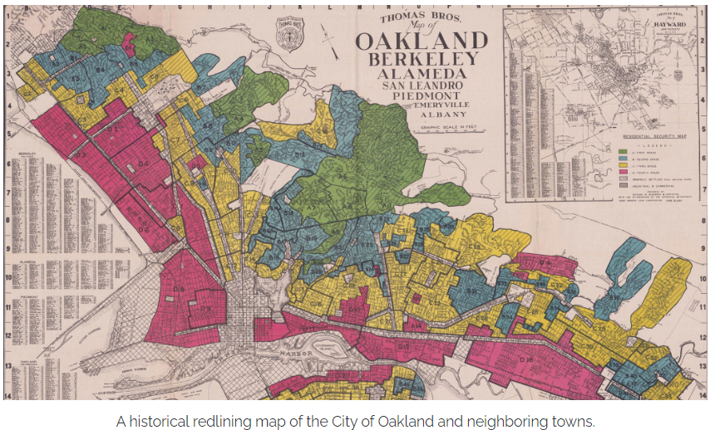
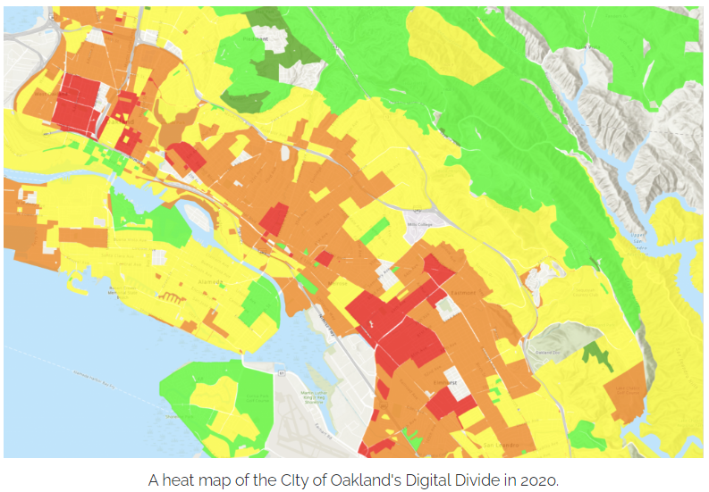
Differing intents, similar outcomes
A loan provider from the mid-1900s
An ISP service manager in 2020
“I do not want to give loans to non-white applicants, so I deliberately do not offer services to minority neighborhoods.”
“I don’t want to discriminate against anyone, so we choose where to offer high-speed service by looking at expected returns – and never at race.”
A historical redlining map of the City of Oakland and neighboring towns
Creditworthy Population
Declining
A heat map of the City of Oakland’s Digital Divide in 2020
Still Desirable
Hazardous
Fast internet speeds
Below average speeds
Average speeds
Far below average
Sources:
https://greenlining.org/publications/online-resources/2020/on-the-wrong-side-of-the-digital-divide/
https://itif.org/publications/2022/04/13/broadband-myths-do-isps-engage-digital-redlining/ https://www.calcities.org/news/post/2021/10/20/oakland-is-closing-the-digital-divide-through-oakwifi-and-education

Slide 4

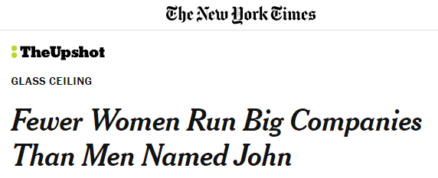
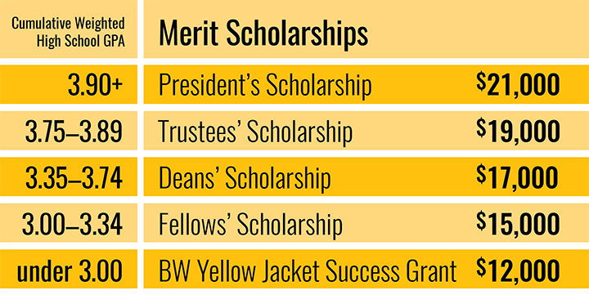
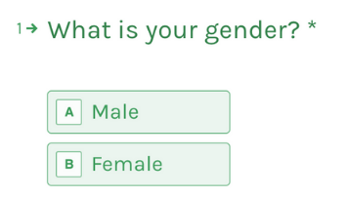
Fairness doctrines: Outcomes v. Processes
From Justice¹
From Harms²
From Law³
Distributive
Procedural
Allocative
Representational
Disparate Impact
Disparate Treatment
outcome-focused
process-focused
1: A Theory of Justice (Rawls): https://www.jstor.org/stable/j.ctvjf9z6v
2: Kate Crawford’s NIPS 2017 Keynote, “The Trouble With Bias”: https://www.youtube.com/watch?v=fMym_BKWQzk; A Framework for Understanding Sources of Harm throughout the Machine Learning Life Cycle: https://arxiv.org/pdf/1901.10002.pdf
3: Big Data’s Disparate Impact (Barocas and Selbst): https://www.californialawreview.org/wp-content/uploads/2016/06/2Barocas-Selbst.pdf; Bloomberg News: https://www.bloomberg.com/graphics/2016-amazon-same-day/
Notes:
First, this is not an exhaustive list and just looks at one schema (outcomes vs. processes) – later on in the class, we’ll look at other schemas for understanding fairness, like individual vs. group fairness.
Distributive : Requires outcomes to be allocated in a way that is “socially just”; Rawls says that this requires a schema where there are equal rights, equal opportunity, and a focus on allocating resources to those who need them the most.
E.g. need-based financial aid
Procedural: Requires the same set of transparent and non-discriminatory policies to be applied to everyone; basically due process
E.g. merit-based financial aid
Allocative: Requires that resources are not withheld from certain people/groups compared to others
E.g. due to a variety of reasons, women are rarely made CEOs of companies
Representational: Requires that people/groups are not stigmatized/stereotyped, even if they all receive the same “allocative” outcome in the end
E.g. misgendering by an AI system that only recognizes binary/cis gender expressions
Disparate impact: “policies or practices that are facially neutral but have a disproportionally adverse impact” on certain groups
E.g. Amazon’s same-day delivery availability is clustered in predominantly white neighborhoods, even though they don’t consider race in deciding where to offer it
Disparate treatment: Policies or practices that contain “disparate treatment of similarly situated people and intent to discriminate”
E.g. redlining
Most mathematical measurements for fairness focus more on outcomes, but sometimes are constrained by process. No matter what doctrine you’re following, the big question at the end is: how do you measure any of these??

Slide 5




INTERDISCIPLINARY DEFINITIONS of fairness
The general concept of fairness is familiar to most but assumes different pursuit of end goals in different disciplines
Law
Social science
Quantitative fields
Philosophy
Fairness includes protecting individuals and groups from discrimination or mistreatment with a focus on prohibiting behaviors, biases and basing decisions on certain protected factors or social group categories.
Fair Housing Act, Equal Credit Opportunity Act, Americans with Disabilities Acts, Title VII of the Civil Rights Act and the Age Discrimination in Employment Act
“often considers fairness in light of social relationships, power dynamics, institutions and markets.”
Social contract theory
(i.e., math, computer science, statistics, economics): questions of fairness are seen as mathematical problems.
Fairness tends to match to some sort of criteria, such as equal or equitable allocation, representation, or error rates, for a particular task or problem.
Design of market, Voting mechanisms, statistical and machine learning models.
Ideas of fairness “rest on a sense that what is fair is also what is morally right.” Political philosophy connects fairness to notions of justice and equity.
Virtue ethics, deontological ethics
Deirdre K. Mulligan, Joshua A. Kroll, Nitin Kohli, and Richmond Y. Wong. 2019. This Thing Called Fairness: Disciplinary Confusion Realizing a Value in Technology. Proc. ACM Hum.-Comput. Interact. 3, CSCW, Article 119 (November 2019), https://arxiv.org/abs/1909.11869
Notes:
2.5 minutes
- Fairness defined and operationalized within different disciplinary and professional contexts.

Slide 6
Reading presentation #1:
Inherent Trade-Offs in the Fair Determination of Risk Scores
Notes:
5 minutes

Slide 7
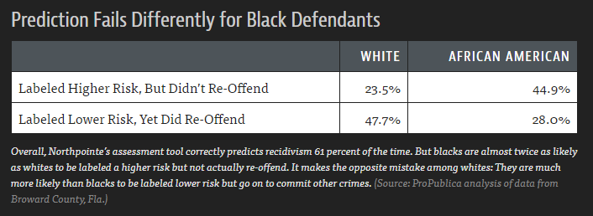
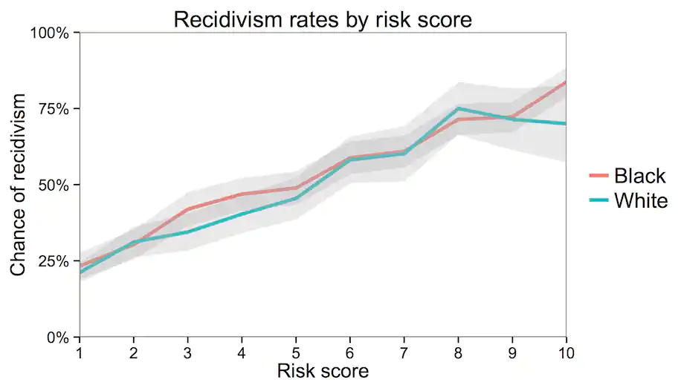
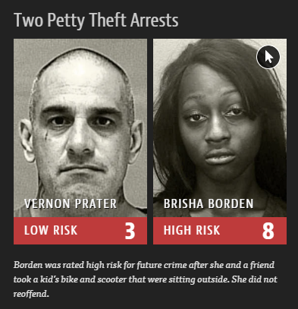
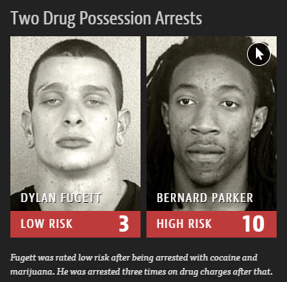
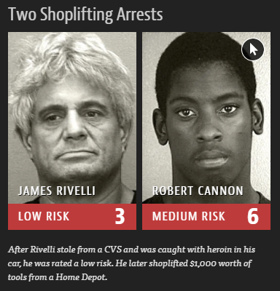
THE IMPOSSIBILE QUEST…
False Positive & False Negative Rates
Calibration
“Do the algorithm’s mistakes affect Black and white defendants in the same way?”
“Can scores be interpreted the same way for both Black and white defendants?”
https://www.propublica.org/article/machine-bias-risk-assessments-in-criminal-sentencing
https://www.washingtonpost.com/news/monkey-cage/wp/2016/10/17/can-an-algorithm-be-racist-our-analysis-is-more-cautious-than-propublicas/?variant=116ae929826d1fd3
http://go.volarisgroup.com/rs/430-MBX-989/images/ProPublica_Commentary_Final_070616.pdf
Notes:
4 minutes
In addition to FPR/FNR (Is the model accurate in identifying potential harms equally for members of each protected class?) and calibration (Does the model make accurate predictions, in aggregate, for members of each class? How well is the model calibrated for each protected class? How do these calibration profiles compare to each other?) there are also additional metrics like balance (Is the average score received by individuals in positive and negative instances similar across protected classes?) and legal heuristics like the four-fifths rule (Is the rate of intervention substantially different for members of different classes?)
Conflicts among measures:
Mathematically formulated criteria do not encompass the multi-faceted conceptualization of fairness compatible with diverse disciplines.
The satisfiability of measures conflict with each other.
Constraining the models to satisfy outcome parity measures penalizes overall accuracy.
“although recent debates about fairness definitions have been framed in terms of operationalizations, they are, in fact, debates about different theoretical understandings of fairness—i.e., about the essentially contested nature of fairness as a construct” (from Measurement and Fairness)

Slide 8
Reading presentation #2:
Who Audits the Auditors?
Notes:
5 minutes

Slide 9
example: facial recognition technology (FRT)
FRT product(s)
Notes:
1 min

Slide 10
example: facial recognition technology (FRT)
Public school system
purchases/uses
Large company
Tech vendor
FRT product(s)
purchases/uses
creates
purchases/uses
Cell phone manufacturer
purchases/uses
Police department
Notes:
1 min

Slide 11
example: facial recognition technology (FRT)
Students
are surveilled
Public school system
implement
Teachers
purchases/uses
Applicants
Large company
are surveilled
purchases/uses
implement
HR employees
Tech vendor
FRT product(s)
creates
purchases/uses
Cell phone manufacturer
Users
purchases/uses
Society
Police department
are surveilled
implement
Police
Notes:
1 min

Slide 12
example: facial recognition technology (FRT)
live in
Students
regulators
are surveilled
Tech vendor’s employees
Public school system
implement
Teachers
purchases/uses
Applicants
Large company
are surveilled
employs
work for
purchases/uses
implement
HR employees
Tech vendor
FRT product(s)
creates
purchases/uses
Cell phone manufacturer
Users
impacts
uses
purchases/uses
Environment
Data
Society
Police department
are surveilled
label
implement
Data labelers
Police
captured in
Notes:
1 min

Slide 13
DISCUSSION
Consider a home loan provider that takes a variety of demographic and financial information from applicants, puts the features into a model, and uses it to decide whether an applicant is eligible for a loan.
Who all are the likely stakeholders in this example? What is the impact of a correct* decision on each type of stakeholder? An incorrect decision?
In breakout rooms, take five minutes to whiteboard a stakeholder map and discuss the potential impact of true/false positives/negatives to different stakeholders.
Make sure to nominate someone to (1) screenshot your stakeholder map before the breakout rooms close and (2) share it with the room when we reconvene!
*Bonus: how are you defining “correct”? How do you think the model defines it?
Notes:
10 minutes

Slide 14
FOR NEXT WEEK
Complete next week’s readings
If you sign up to present on Datasheets for Datasets, come prepared to present next week and submit your presentation on Gradescope by 10AM PT on Friday, October 14
Submit your answers to next week’s participation questions to Gradescope by 10AM PT on Thursday, October 13
Submit your response to Writeup #2 to Gradescope by 10AM PT on Friday, October 14

